Slide 1


www.iKumpra.com

Slide 2

What is iKumpra?
iKumpra is an online portal where shoppers can have their market products delivered to their doorsteps.
www.iKumpra.com

Slide 3
What is iKumpra?
We also aim to help local farmers and fishermen sell their products at a competitive price by eliminating the need of a middle man.
www.iKumpra.com

Slide 4
Why use iKumpra?
Affordable Prices
Hassle Free Transaction
Saves time
Avoid the inconvenience of traffic
Have your items delivered
www.iKumpra.com

Slide 5
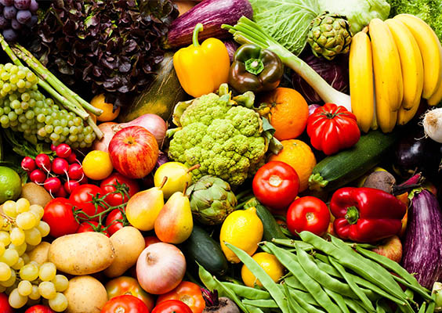
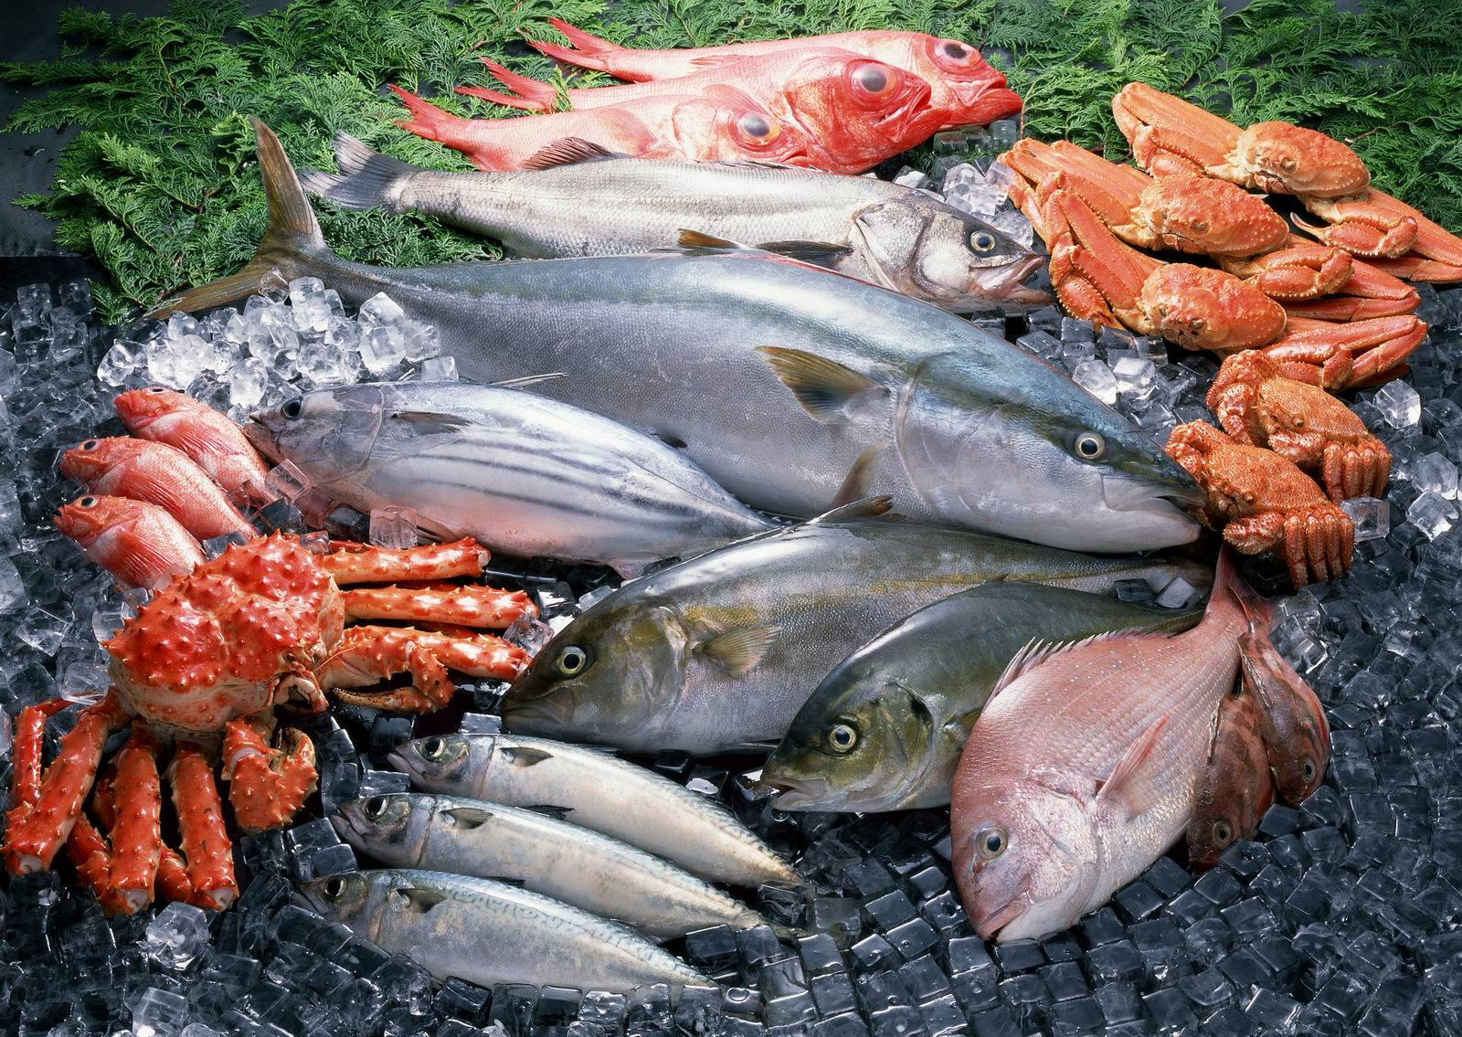
Available Items
At the moment we offer
Fruits & Vegetables
Fish
www.iKumpra.com

Slide 6


Available Items
But we are looking forward to have
Meat & Poultry
Grocery Items
www.iKumpra.com

Slide 7


Available Items
But we are looking forward to have
Condiments
Home Cooked Meals
www.iKumpra.com

Slide 8



How to order?
Step 1
Step 2
Step 3
Go to the website to place your order
Proceed to Checkout
Pay cash on delivery
www.iKumpra.com

Slide 9
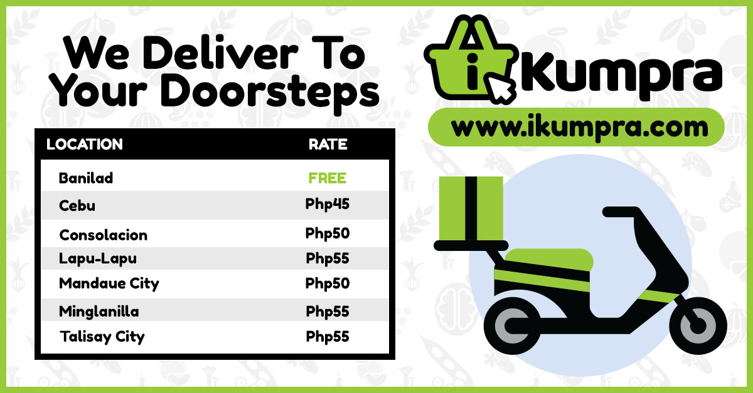
Delivery Rates
www.iKumpra.com

Slide 10
For More Information:
Maynard Paye
09436221199
www.iKumpra.com

